Slide 1

Accessibility fundamentals to drive your web apps into the future
Presented by Aurelia Towell
Consultant, Daugherty Business Solutions
Notes:
Have the following open in the browser:
Your app
https://www.deque.com/blog/writing-automated-tests-accessibility/
https://webaim.org/resources/contrastchecker/
Accessibility tree of some site

Slide 2

Notes:
Thank you to our sponsors

Slide 3
Full PowerPoint and app:
https://github.com/atowell1/a11y-demo-app

Slide 4

100%
Notes:
There is no such thing as a 100% accessible website.
Be wary of tools or companies that claim they can provide 100% coverage.
It’s an iterative process, things are always changing, but we can strive to do our best.
On previous team’s we made it part of AC to fall between 70 and 85% accessible when running compliance checkers.
And if you’re asking, Aurelia how do I know my site’s Accessibility percentage, we’ll get to that in our testing section.

Slide 5
Agenda
Compliance Standards
Planning
Design
Color, Pattern, Layout and Responsiveness
Code
API, Tree, Accessible Names, Semantics, Aria, Alt-text,
Testing

Slide 6
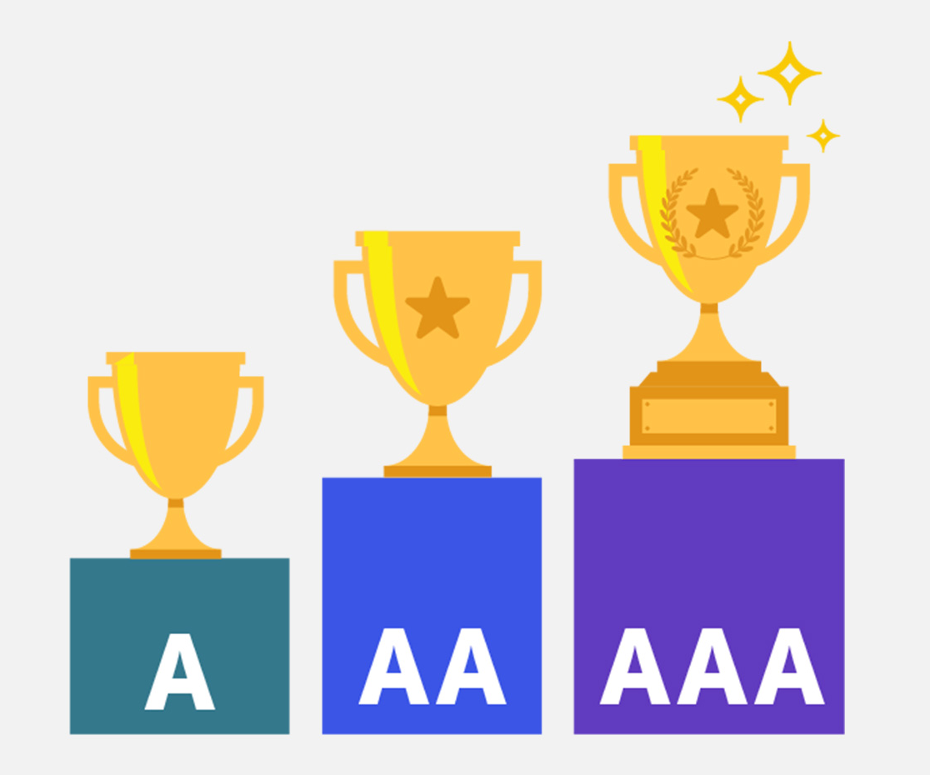
Web Content Accessibility Guidelines (WCAG)
shared standards around the world
3 levels of standards
A: Essential
AA: Ideal
AAA: Specialized
Notes:
3 levels of compliance - each progressively stricter, but each level making a site more accessible to more people
Essential – if not met, assistive technology may not be able to read, understand, or fully operate the page or view Ideal – required for government and public body websites
Specialized – typically reserved for parts of websites and web apps that serve a specialized audience

Slide 7
Planning
Start early
‘Accessibility mindset’
Teamwork
Budget
Notes:
Start early – almost always easier, more effective, and less expensive
Integrate ‘accessibility mindset’ into the process
Consideration at every step in a product’s lifecycle
Team – from Leadership all the way down, your team needs to understand their role in making accessibility happen. Every role has a part to play. You may need to provide training or hire a specialist
https://alistapart.com/article/planning-for-accessibility/

Slide 8




Color
No affliction
Protanopia
Deuteranopia
Tritanopia
Notes:
Color blindness affects approximately 1 in 12 men and 1 in 200 women
Choose high contrast colors and when in doubt, test them using the contrast checker from WebAIM

Slide 9
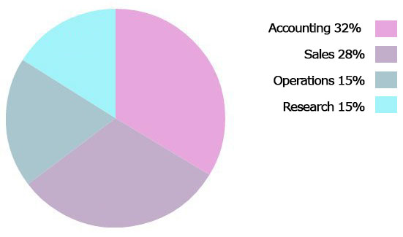
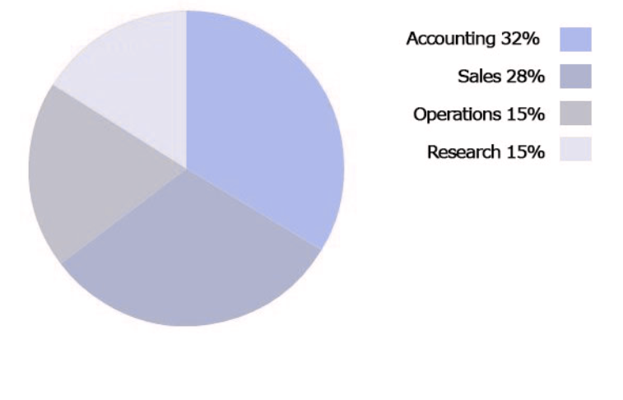
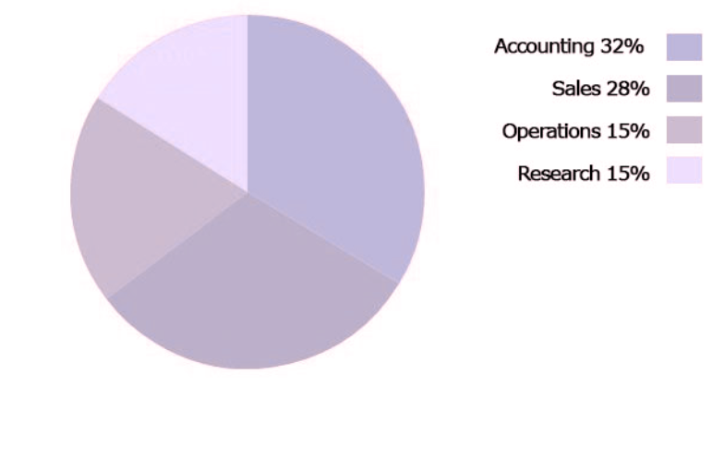
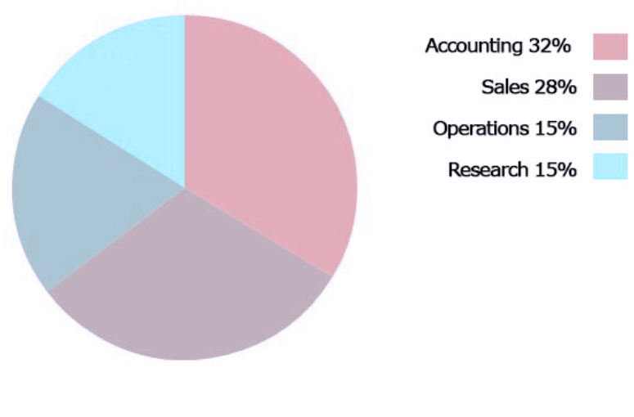
No affliction
Protanopia
Deuteranopia
Tritanopia
Notes:
https://www.color-blindness.com/coblis-color-blindness-simulator/
If in doubt, check your color decisions. And if you can, make it even simpler on users and don’t rely on color alone

Slide 10
Pattern
Notes:
Where color alone cannot demonstrate differences, we can add pattern to display data.

Slide 11
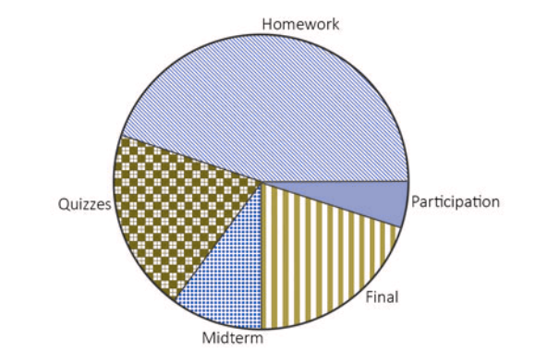
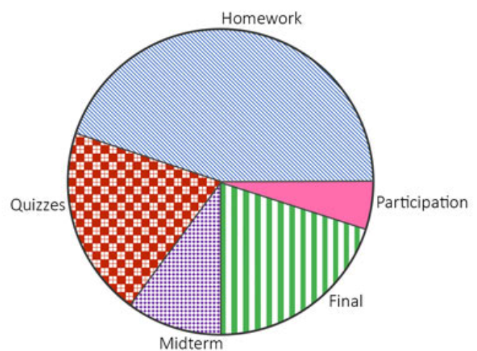
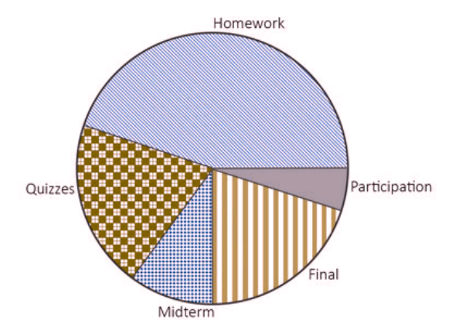
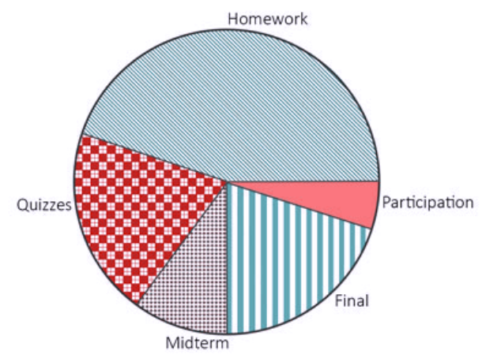
No affliction
Protanopia
Deuteranopia
Tritanopia
Notes:
Instead You can distinguish data with patterns AND color and your users will be much more likely to see exactly what you are presenting to them

Slide 12
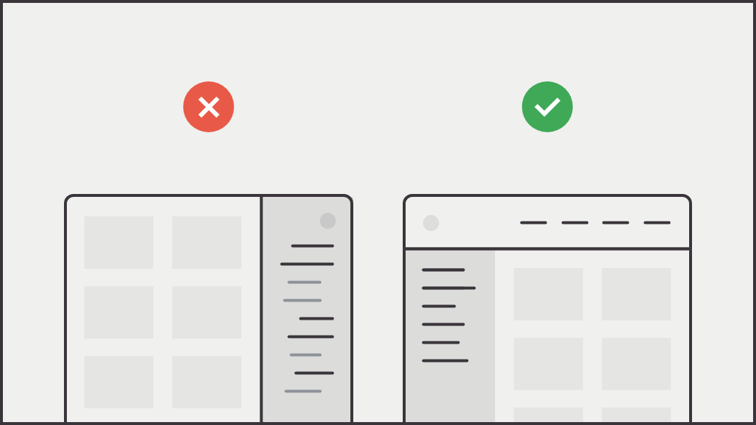
Layout & Responsiveness
Notes:
Use EXPECTED behaviors to influence layout and keep things consistent across pages
Make sure the responsiveness corresponds across devices
A great example is Hulu – they overline the user when you look to switch profiles. Bc my learned behavior is that things are undelined, 50% of the time I switch to the wrong account. Ex: account info is usually top right and main nav bars are usually at the top of the page as well

Slide 13
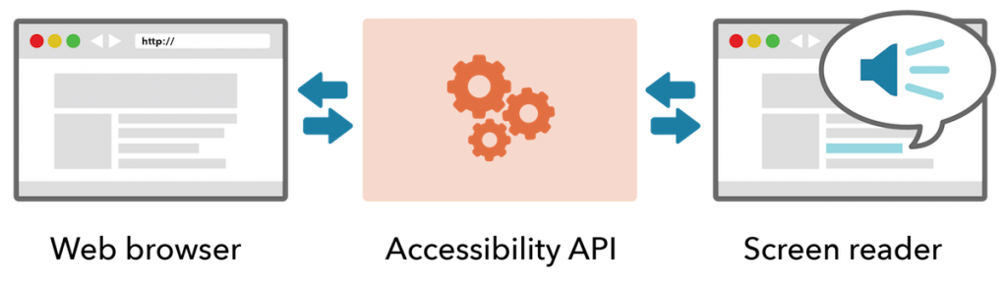
Accessibility API
Notes:
Just like a DOM, accessibility has an Accessibility API. It is very similar to the DOM API.
It exposes objects and events to assistive technology through this API.
This is the connector we need to get the information from the web browser to the screen reader.

Slide 14
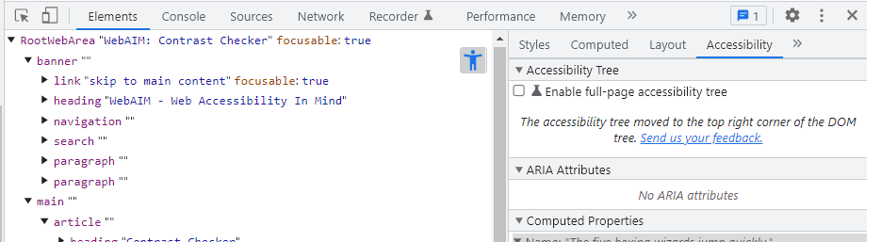
Accessibility Tree
DOM → Accessibility Tree
This is an accessible representation of the UI structure and what is exposed to AT via the Accessibility API
Notes:
Browsers convert the DOM into the Accessibility Tree
The tree is what AT reads via the Accessibility API
Besides just giving context to how AT reads the DOM, this can also be used as a tool to find accessibility issues within your site
To see a websites tree, access in the browser, access the Developer Tools and with the Elements tab selected you’ll find an Accessibility sub-tab

Slide 15
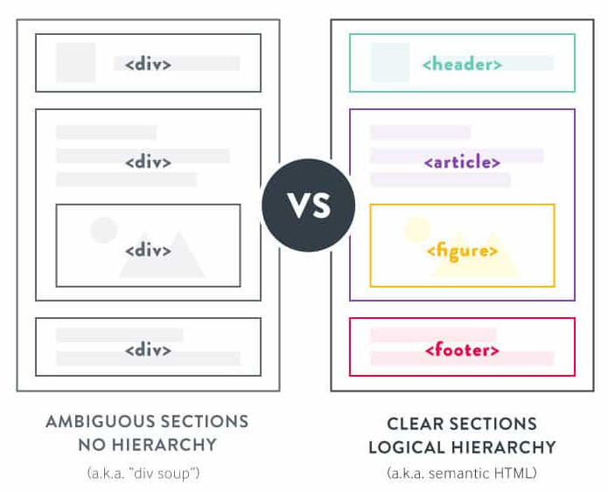
Semantics
Notes:
Semantics are very important for screen readers as they can’t structure and content without it
But it’s also important for devs. Using semantics saves time and gives you some “out-of-the-box” accessibility

Slide 16
Accessible Names
WCAG requires all focusable, interactive elements to have an accessible name
This name is communicated to users of AT when an element receives focus
The value can be visual content or hidden text alternatives
Notes:
Accessible names are required and only needed for interactive elements
So divs and spans do not need accessible names
Screen readers read these names aloud
Depending on the context the value may be visual or hidden
Using semantics often gives us the Accessible name we need
For example, a button's accessible name is the content between the opening and closing <button> tags

Slide 17
ARIA & Aria-attributes
Accessibility Rich Internet Applications
Help assistive technologies understand the states and properties of interactive elements when there is no alternative
Notes:
Aria stands for Aria Rich Internet Application
These attributes help make content and apps more accessible

Slide 18

THE FIRST RULE OF ARIA IS
DON’T USE ARIA
NO ARIA IS BETTER
THAN BAD ARIA
Notes:
If you don’t mind me mixing my movie themes for just a moment
If you can use semantic HTML without adding an ARIA role, state or property to make it accessible, that is the best path to take
"No ARIA is better than bad ARIA."
In a study conducted by WebAim, they found that pages with ARIA present averaged 41% more detected errors than those without ARIA.
ARIA is designed to make web pages more accessible, if used incorrectly, it can do more harm than good.

Slide 19
Aria-labelledby
Enables reference to OTHER elements on the page to define an accessible name
overrides other methods of naming the element (aria-label)
Takes an id reference list
Value order matters
Aria-label & Aria-labelledby
Notes:
When you can’t use semantics to give something an accessible name you will use Aria and Aria Labelledy by
Labelledby:
Longer content that provides a description
overrides other methods of naming the element, including aria-label, other naming attributes, and even the element's contents.
Takes an ide

Slide 20
Aria-label
Names an element that is not visually rendered
Only ‘visible’ to AT
Notes:
aria-label can be used in cases where text that could label the element is not visible. If there is visible text that labels an element, use aria-labelledby instead.

Slide 21
Alt-text
“alternative text”
Provides context for non-text elements such as images
Functional for accessibility and beyond
Notes:
https://webaim.org/techniques/alttext/
Images
Multimedia
Graphs
Functional for :
Screen readers
Loading failures or blocking
Search engines

Slide 22
Alt-text Attributes
accurate and equivalent
succinct
not redundant
not include phrases like "image of ..." or "graphic of ...", etc.
Notes:
be accurate and equivalent in representing content and function.
Typically, only a few words are necessary, though rarely a short sentence or two may be appropriate.
not be redundant or provide the same information as text near the image.
not include phrases like "image of ..." or "graphic of ...", etc. This would be redundant since screen readers already announce "graphic" along with the alt text. If the fact that an image is a photograph or illustration, etc. is important content, it may be useful to include this in alternative text.

Slide 23
Manual Testing Checklist*
Labels
Audio/video content
Color contrast
Tab navigation/keyboard
Hierarchy
Semantics
Link text
Captions
Alt-text
Actionable items
Forms
Notes:
2 types of testing: Manual
Automated
Not a comprehensive list
WAVE demo

Slide 24
Tools
Color contrast checker: https://webaim.org/resources/contrastchecker/
Compliance checkers:
WAVE - https://wave.webaim.org/
IBM Equal Access - https://chrome.google.com/webstore/detail/ibm-equal-access-accessib/lkcagbfjnkomcinoddgooolagloogehp?hl=en-US
https://www.tawdis.net/
Disability simulator: https://www.eclipse.org/actf/downloads/tools/aDesigner/
Web-based screen reader: https://webinsight.cs.washington.edu/wa/

Slide 25
Resources
deque.com
webaim.org
w3schools.com/accessibility/
Government resources: Section 508 of the Rehabilitation Act
w3.org/WAI/
developer.mozilla.org/en-US/docs/Web/Accessibility
Pro-tip: Most libraries have accessibility documentation. Be sure to read through it so you can take advantage of its features.

Slide 26
Thank You
Have Questions?
Come chat with me at the
Daugherty Business Solutions booth

